Slide 1
Loan Approval Prediction
By: Noble Stephen

Slide 2
What Is Loan?
In finance, a loan is the transfer of money by one party to another with an agreement to pay it back. The recipient, or borrower, incurs a debt and is usually required to pay interest for the use of the money.
When someone needs money, they apply for a loan from a bank, corporation, government, or other entity. The borrower may be required to provide specific details such as the reason for the loan, their financial history, Social Security number (SSN), and other information. The lender reviews this information as well as a person's debt-to-income (DTI) ratio to determine if the loan can be paid back.

Slide 3
Objective:
To discover insights about how the loan has been approved.

Slide 4
Problem Statement:
The company wants to automate the loan eligibility process (real-time) based on customer detail provided while filling the online application form.
To automate this process, they have given a problem to identify the customer's segments, those are eligible for loan amount so that they can specifically target these customers.

Slide 5
Steps For Model Building:
Importing Data
Data Cleaning
EDA
Train Test Split
Model Building On Training And Test Data
Checking Accuracy

Slide 6
About Variables:
loan_id: Unique loan ID.
no_of_dependents: Number of dependents of the applicant.
education: Education of the applicant (Graduate/Not Graduate).
self_employed: Employment status of the applicant.
income_annum: Annual income of the applicant.
loan_amount: Loan amount requested by the applicant.
loan_term: Tenure of the loan requested by the applicant (in Years).
cibil_score: Credit score.
residential_assets_value: Value of the residential asset of the applicant.
commercial_assets_value: Value of the commercial asset of the applicant.
luxury_assets_value: Value of the luxury asset of the applicant.
bank_asset_value: Value of the bank asset of the applicant.
loan_status: Loan Approval Status (Approved/Rejected).

Slide 7
Exploratory Data Analysis
Data pre-processing, Feature Engineering, and EDA are fundamental early steps after data collection.
Data pre-processing involves cleaning and preparing raw data to facilitate feature engineering
Feature engineering entails employing various techniques to manipulate the data. This may include adding or removing relevant features, handling missing data, encoding variables, and dealing with categorical variables, among other tasks.

Slide 8
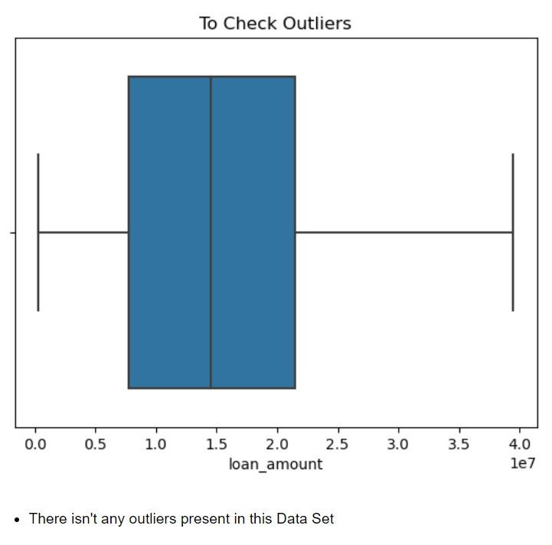
Graphs: Graphs are used because they can show complex data in a simple and concise way
Box plots are used to check if there is any outlying data in a data set. Using following graph we can understand there is no outliers present in this column.

Slide 9
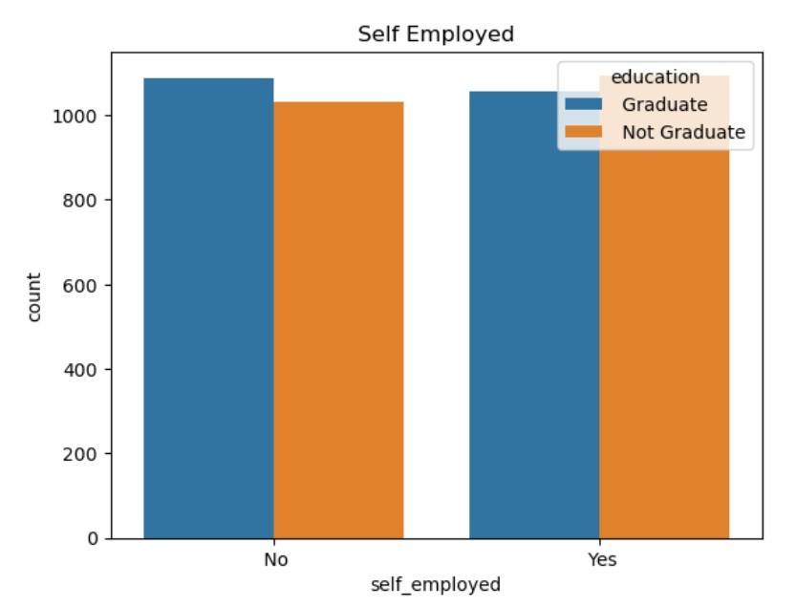
Bar Chart on Employment and Education
This graph depicts the relationship between the employment status of applicants and their education levels which highlights important trends for loan approval considerations.
It reveals that a majority of non-graduate applicants are self-employed, while most graduate applicants are not self-employed which this indicates that graduates are more likely to be employed in salaried positions, whereas non-graduates tend to be self-employed.

Slide 10
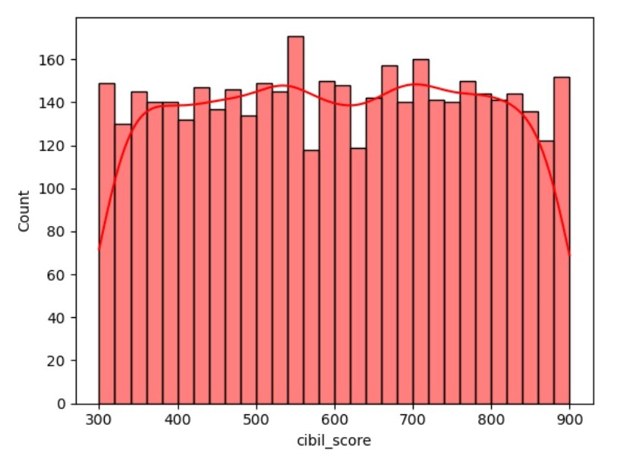
Histogram showing customer’s cibil score
Looking at the table, most customers have low CIBIL scores (below 669), which could make it hard for them to get loans approved.
But there's a good number of customers with high scores (above 669).
People with high CIBIL scores are more likely to get their loans approved.

Slide 11
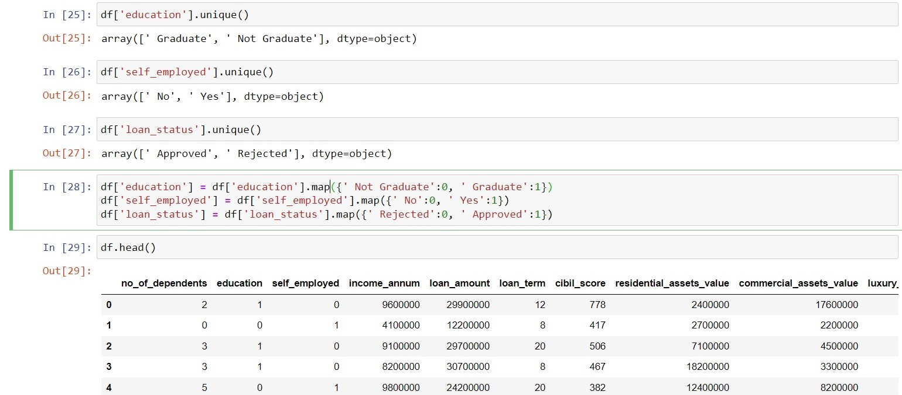
Converting Categorical Data To Numerical Data:
It is a very necessary step because Machine Learning Model cannot process Categorical Data.

Slide 12
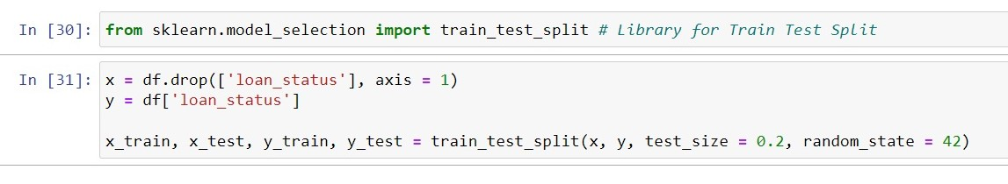
Train Test Split:
In this step our population data is split into:
Y (Dependent Variable) which is “loan_status” in current project
X (Independent Variable) which is rest of columns
Respective X and Y variables are split into training data and test data according to test size assigned

Slide 13
Algorithms Implemented & It’s Accuracy:
Logistic Regression: 72%
Decision Tree: 97%
Random Forest: 97%

Slide 14
Conclusion
When looking at different ways to predict if loans will be approved or not, we found that the Decision Tree model & Random Forest model worked really well. It was accurate and could predict outcomes quite accurately.
However, Logistic Regression model didn't work well for this dataset. It didn't predict as accurately as the Decision Tree and Random Forest models.
This tells us that picking the right model is really important. The Decision Tree and Random Forest models were great for this data, but Logistic Regression wasn't a good fit.

